Slide 1
Discrete Mathematics BCSC0010
Module 1
Probability

Slide 2
Introduction
Probability theory is a mathematical modeling of the phenomenon of chance or randomness.
Example
If a coin is tossed in a random manner, it can lead head or tail, but we do not know which of these will occur in a single toss.
Any side of the coin is as likely to occur as the other; hence the chance of getting a head is 1 in 2 which means the probability of getting heads is ½.

Slide 3
Basic Terminologies
Experiment:
An experiment is any activity from which results are obtained.
Random Experiment:
In which the outcomes, or results, cannot be predicted with certainty.
Examples:
Flip a coin
Roll a die

Slide 4
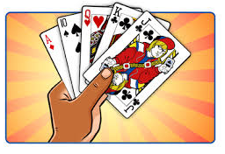
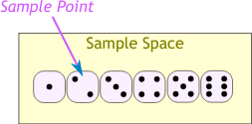
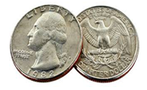
Basic Terminologies
Sample Space:
The set of all possible outcomes of an experiment.
Examples:
For 52 cards in a deck, the sample space
is all 52 cards.
When you roll 1 die, the sample space is
1, 2, 3, 4, 5, or 6
Sample space for the coin toss experiment is {H,T} .

Slide 5
Basic Terminologies
Event:
An event is a set of outcomes from the sample space or, in other words, a subset of the sample space S.
Example
Getting a Tail when tossing a coin is an event
Rolling a "5" is an event.
An event can include several outcomes:
Choosing a "King" from a deck of cards (any of the 4 Kings) is also an event
Rolling an "even number" (2, 4 or 6) is an event

Slide 6
Types of Events
Independent Events
Each event is not affected by any other events.
Example:
You toss a coin three times and it comes up "Heads" each time ... what is the chance that the next toss will also be a "Head"?
The chance is simply 1/2, or 50%, just like ANY OTHER toss of the coin.
What it did in the past will not affect the current toss!
Next toss of the coin is totally independent of any previous tosses.

Slide 7
Types of Events
Dependent Events
Event can be affected by previous events.
Example:
Drawing 2 Cards from a Deck
After taking one card from the deck there are less cards available, so the probabilities change!

Slide 8
Replacement: When we put each card back after drawing it the chances don't change, and the events are independent.
Without Replacement: The chances will change, and the events are dependent.

Slide 9
Types of Events
Mutually Exclusive
It means we can't get both events at the same time.
It is either one or the other, but not both.
Examples:
Turning left or right are Mutually Exclusive
Heads and Tails are Mutually Exclusive
Kings and Aces are Mutually Exclusive
What isn't Mutually Exclusive?
Kings and Hearts are not Mutually Exclusive, because we can have a King of Hearts!

Slide 10
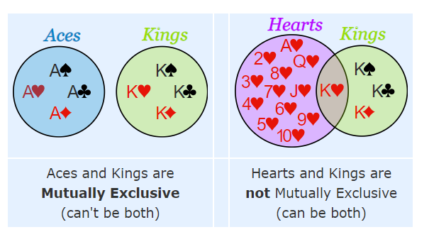

Slide 11
Probability
Chance of happening an event
If the number of outcomes favourable to event A are denoted by n(A) and total number of outcomes in sample space are denoted by n(S).
Then probability of an event A, P(A) = n(A)/n(S).
The probability of an event can vary between 0 to 1, i.e. 0 ≤ P ≤ 1.
Probability can never be negative.
Probability of occurrence of an event = 1 – (Probability that it doesn’t occur).
Probability can be expressed as a fraction or %.

Slide 12
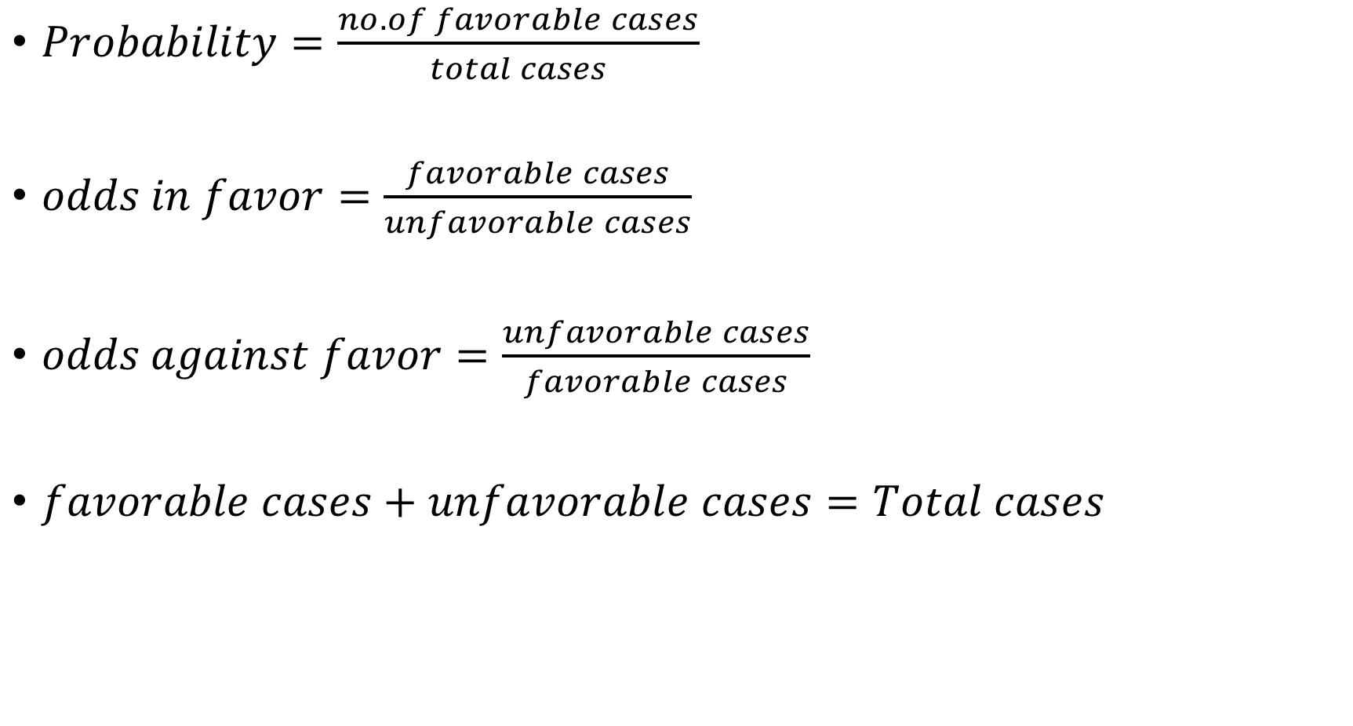
$Probability=\frac{no. of favorable cases}{total cases}$
$odds in favor=\frac{favorable cases}{unfavorable cases}$
$odds against favor=\frac{unfavorable cases}{favorable cases}$
$favorable cases+unfavorable cases=Total cases$

Slide 13


Probability of word made by APPLE in which both P are together
$Probability=\frac{no. of favorable cases}{total cases}$
=
= 2/5
$$\frac{P\left(4,4\right) }{P(5,5)/2!}$$

Slide 14

3 boys and 3 girls are to arrange in a line. What is the probability of all boys sit together.
$Probability=\frac{no. of favorable cases}{total cases}$
= $\frac{P\left(4,4\right)xP\left(3,3\right) }{P(6,6)}$
= 1/5

Slide 15
Problems
Coins
Dice
Cards
Bags and balls

